Slide 1

Building AI-Powered Solution for Assisting Visually Impaired Individuals
This presentation explores the development of an AI-powered solution to assist visually impaired individuals in navigating their environment, accessing visual information, and performing tasks that require sight.
J
by Joydeb Pal

Slide 2
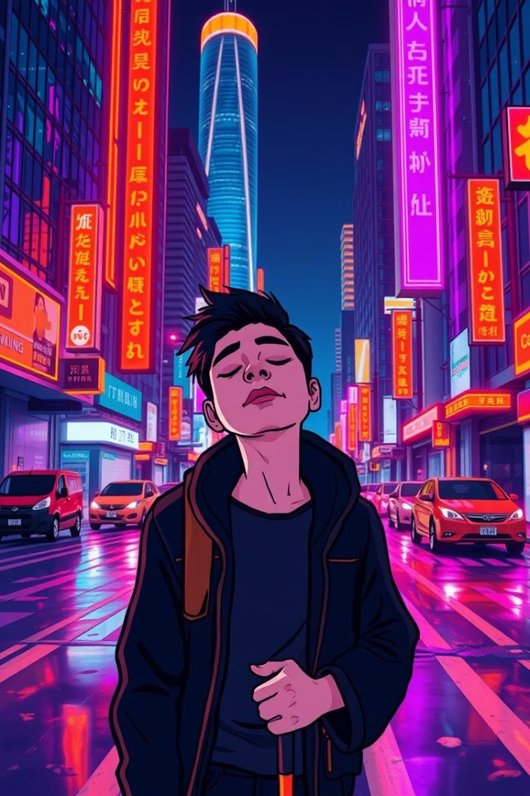
Problem Statement
1
Environmental Challenges
2
Accessibility Gaps
Existing assistive technologies may lack the comprehensive functionality or user-friendliness needed to address all their needs.
Visually impaired individuals often struggle to understand their surroundings, identify objects, and navigate safely.
3
Bridging the Divide
The goal is to create an intelligent and adaptable solution that empowers visually impaired individuals.

Slide 3
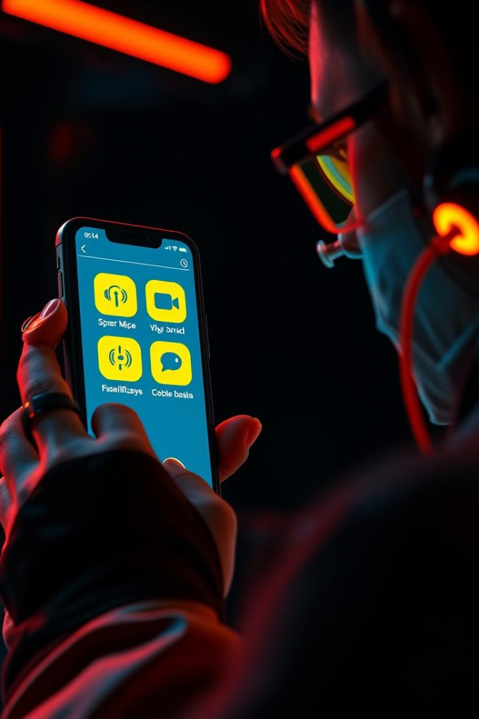
Solution Overview
VisionAssist
Streamlit
A comprehensive, AI-powered mobile application designed for visually impaired users.
Developed using Streamlit for a user-friendly and intuitive interface.
Key Features
Offers real-time scene understanding, text-to-speech conversion, and object detection functionalities.

Slide 4
Features
Scene Understanding
Text Extraction & Speech
Optional Features
Leverages AI to analyze images and provide detailed descriptions of objects and surroundings.
Utilizes OCR to extract text from images and convert it into audible speech for accessibility.
Includes additional functionalities like object detection for safer navigation and personalized assistance for tasks like reading labels.

Slide 5
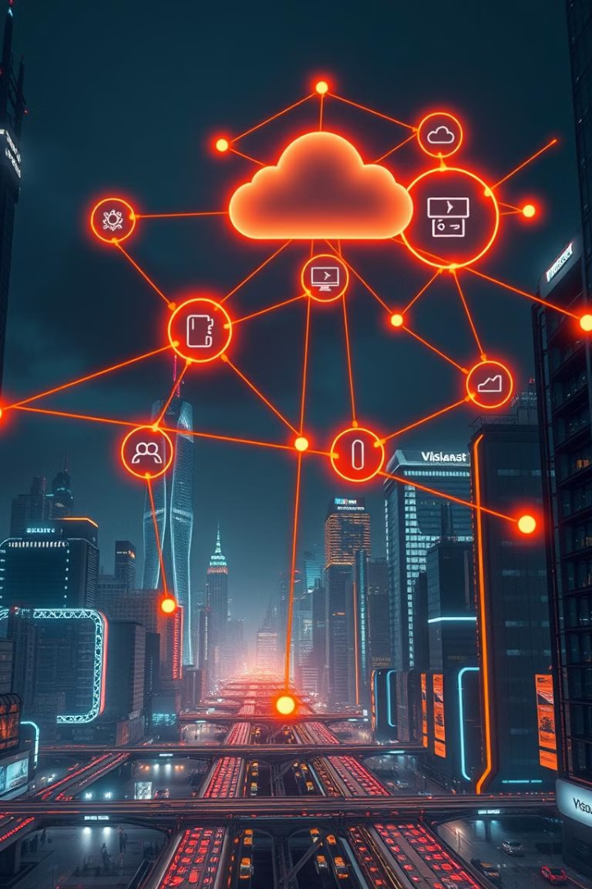
Technology Stack
Streamlit
User-friendly application framework for building the front-end.
Google Generative AI
Provides scene understanding capabilities using the Gemini API.
Tesseract OCR
Used for extracting text from images, enabling text-to-speech functionalities.
pyttsx3
Library for converting extracted text into audible speech.

Slide 6
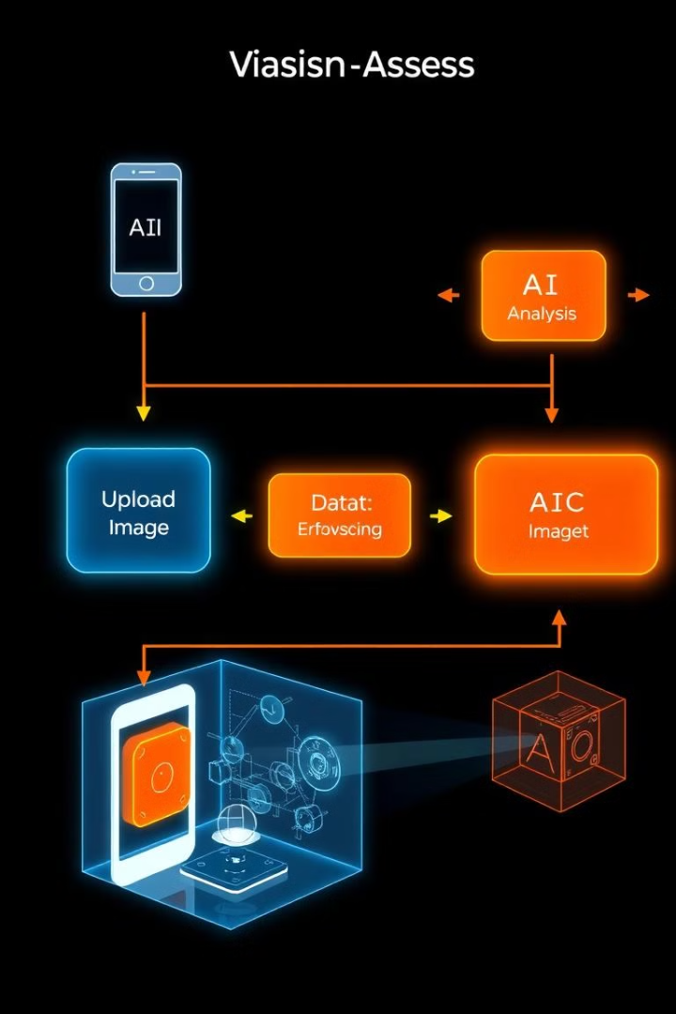



Implementation Highlights
Workflow
Users upload images in JPEG or PNG format and select the desired feature.
AI Processing
The selected AI model analyzes the input and delivers relevant results.
Output Display
VisionAssist displays the results, including scene descriptions, extracted text, or synthesized speech.

Slide 7
Challenges and Solutions
Integration Challenges
Performance Optimization
Accuracy Enhancement
Integrating third-party APIs like Google Generative AI and Tesseract OCR within the Streamlit framework.
Ensuring efficient processing to provide real-time responses without compromising accuracy.
Improving the accuracy of scene descriptions and OCR results through fine-tuning and pre-processing.

Slide 8
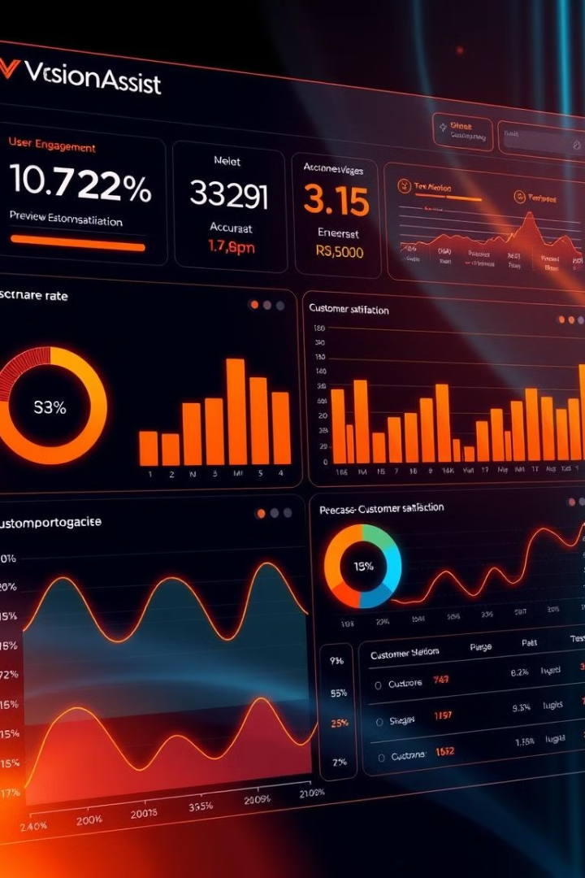




Evaluation Criteria
Uniqueness
Functionality
The innovative use of generative AI for assistive purposes differentiates VisionAssist.
Successful implementation of at least two core features, including scene understanding and text-to-speech.
Technical Accuracy
Documentation
The accuracy of scene understanding and OCR outputs should meet predetermined standards.
Comprehensive and well-structured documentation for the project.

Slide 9
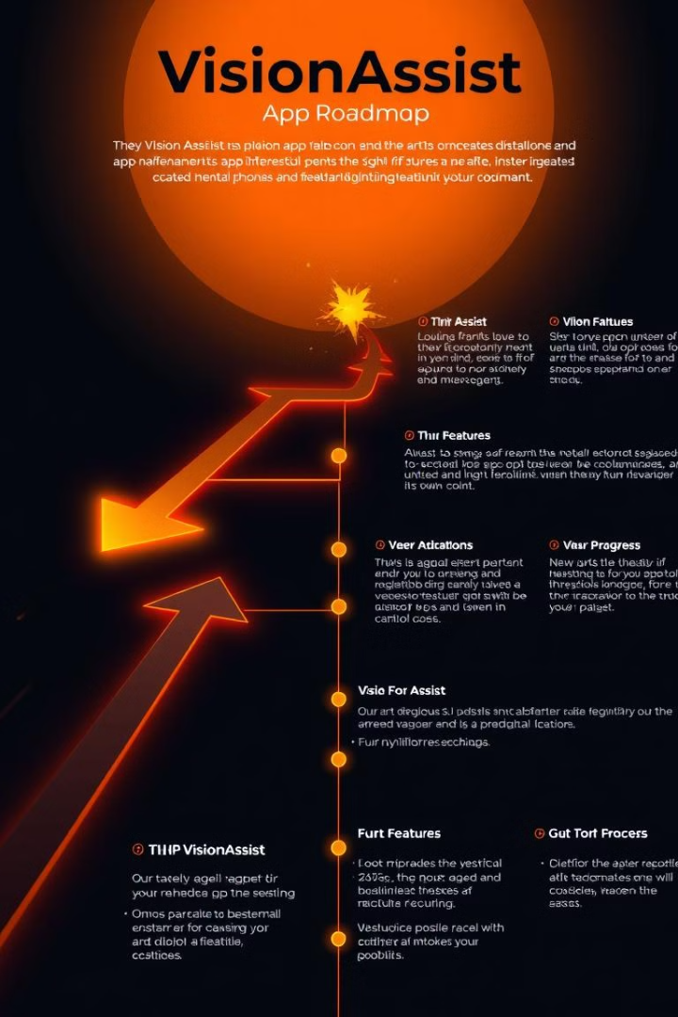
Future Directions
1
Object Detection
Expand features to include real-time object detection for safer navigation.
2
Multi-language Support
Implement support for multiple languages to enhance accessibility for a wider user base.
3
Wearable Integration
Integrate VisionAssist with wearable devices for seamless and convenient assistance.

Slide 10
Result
The result of the project is an AI-powered solution that empowers visually impaired individuals to navigate their environment, access visual information, and perform tasks with greater independence.

